Slide 1

Module 5
Master of Computer Applications III Sem
Subject code – Web Programming
AJAX
Mehtab Mehdi

Slide 2

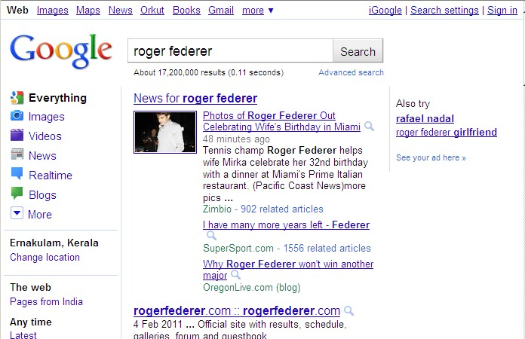
And you get this :
Module No. 5

Slide 3

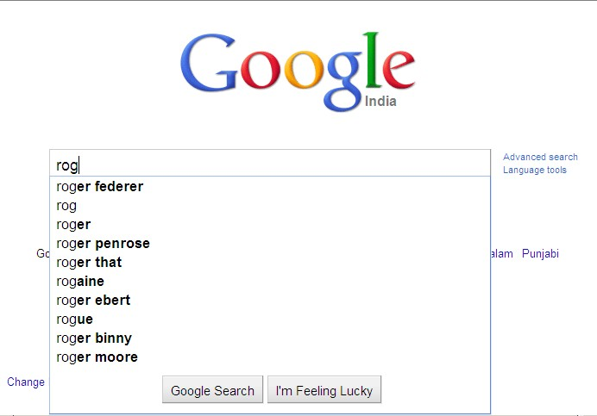
These days :
Module No. 5

Slide 4
Module No. 5
The magic spell behind this is :
AJAX

Slide 5
So what is Ajax ?
Module No. 5
A programming language – no…
A new technology – not exactly…
So what else ?
☺ It is a methodology on using several web technologies together, in an effort to close the gap between the usability and interactivity of a desktop application and the ever demanding web application ☺

Slide 6
Order of Developments
Module No. 5
Internet Explorer introduces the concept of IFrame element in 1996.(a technique that helps in loading the contents of a web page.)
In the year 1998, Microsoft introduces another technique, called ‗Microsoft‘s Remote Scripting‘ as a replacement to the older techniques.

Slide 7
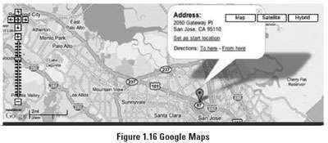

Module No. 5
A year later, in 1999, Microsoft introduces the XMLHttpRequest object, an ActiveX control, in IE 5.
The term AJAX is coined on February 18, 2005, by Jesse James Garret in a short essay published a few days after Google released its Maps application.

Slide 8
Module No. 5
Finally, in the year 2006, the W3C (World Wide Web Consortium) announces the release of the first draft which includes the specification for the object (XHR) and makes it an official web standard.

Slide 9
Why Ajax is important ?
Module No. 5
AJAX enables a much better user experience for Web sites and
applications.
Developers can now provide user interfaces that are nearly as responsive and rich as more traditional Windows Forms applications while taking advantage of the Web's innate ease of deployment and heterogeneous, cross-platform nature.
These benefits have been shown to dramatically reduce software maintenance costs and increase its reach. You can use AJAX to load specific portions of a page that need to be changed.
It further reduces network traffic.

Slide 10
The Core Components :
Module No. 5
HTML & CSS - for presenting.
JavaScript - for local processing.
Document Object Model (DOM) – to access data inside the page or to access elements of an XML file on the server.
XMLHttpRequest object – to read/send data to the server asynchronously.

Slide 11
The process cycle
Module No. 5

Slide 12
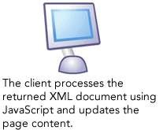
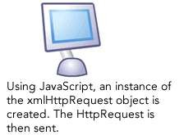

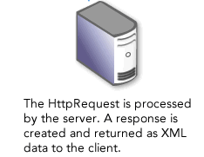
Module No. 5

Slide 13
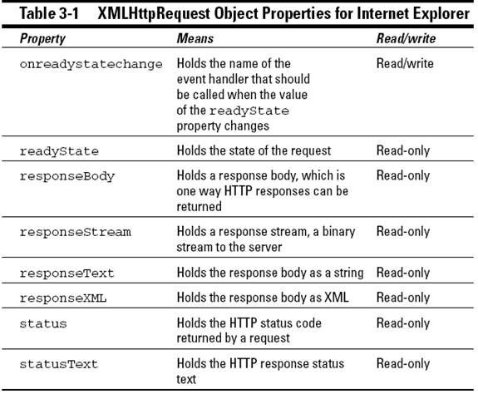

A little about XHR object
Module No. 5

Slide 14
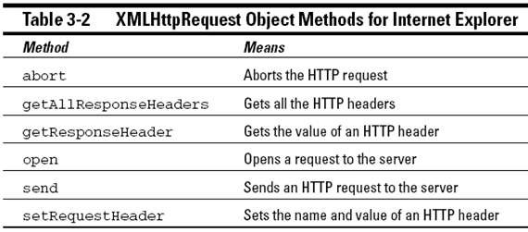
Module No. 5

Slide 15
The readyState values
Module No. 5
State | Description
0 | uninitialized
1 | loading
2 | loaded
3 | interactive
4 | complete

Slide 16
A few status values
Module No. 5
Status | Description
200 | OK
400 | Bad Request
404 | File Not Found
500 | Internal Server Error
505 | HTTP version not supported

Slide 17


Let‘s get to some work ☺
Module No. 5

Slide 18
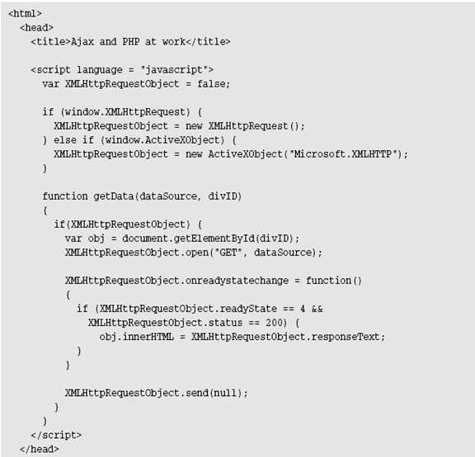
Module No. 5
Example
( cont...)

Slide 19
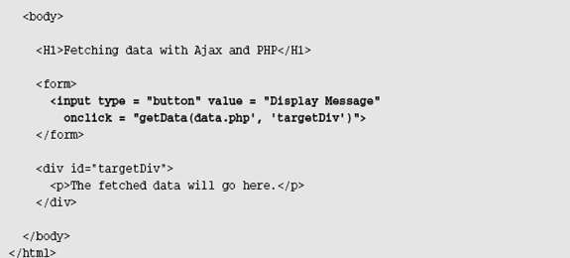
Module No. 5
( cont...)

Slide 20
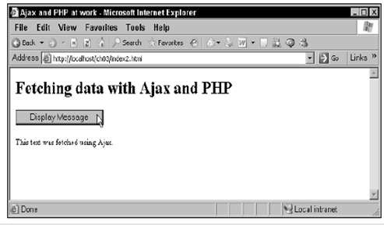
Output page looks like this :
Module No. 5

Slide 21
Interactive mouse-overs
Module No. 5

Slide 22
Module No. 5
Here comes another Ajax example — one that‘s a little more impressive visually.
When you move the mouse over one of the images on this page, the application fetches text for that mouseover by using Ajax.
All you really have to do is to connect the getData function (which fetches text data and displays it in the <div> element whose name you pass) to the ‗onmouseover‘ event of each of the images you see in Figure 3-3.

Slide 23
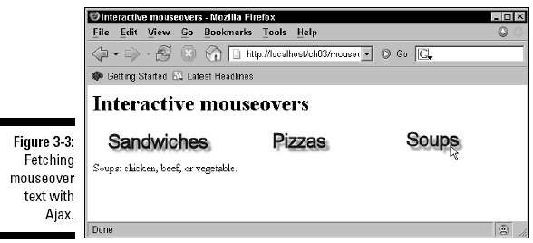
Take a look at this :
Module No. 5

Slide 24
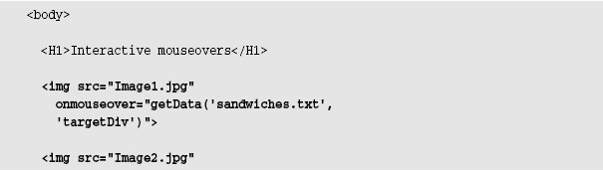
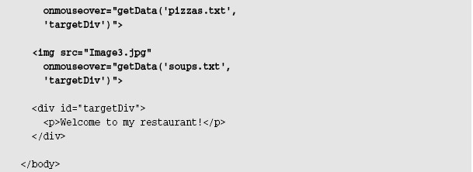
How to do this :
Module No. 5

Slide 25
Module No. 5
Here‘s the content of sandwiches.txt :
and pizzas.txt :
and soups.txt :

Slide 26
☺ Benefits of using Ajax ☺
Module No. 5
Helps to build fast, dynamic websites.
Improves sharing of resources : it facilitates to use the power of all the client computers rather than just a unique server and network.
Ajax allows to perform processing on client computer (in JavaScript) with data taken from the server thereby reducing server load by moving a part of server functionality to client side.
Ajax can selectively modify a part of a page displayed by the browser, and update it without the need to reload the whole document with all images, menus etc. This bridges the gap between desktop and web applications.

Slide 27
☹ A Few Drawbacks ☹
Module No. 5
If JavaScript is not activated, Ajax can't works. The user must be asked to set JavaScript from within options of the browser, with the "noscript" tag.
Since data to display are loaded dynamically, they are not part of the page, and the keywords inside are not viewed by search engines.
The asynchronous mode may change the page with delays (when the processing on the server takes more time), this may be disturbing.
The back button may be deactivated.

